Slide 1
Java SE 8 Book Presentation
Chapter 11 – Java Methods

Slide 2
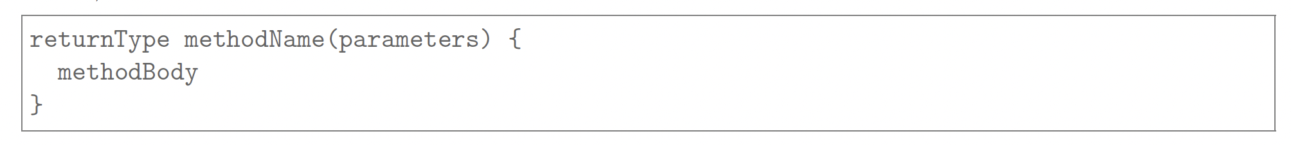
11.1 Create methods with arguments and return values - 11.1.1 Create a method
- Method is basically a “thing” that creates … of an object. … here is just purely an … performed by a piece of …. If we need that … to be performed when we needed and where we needed, we just need to put that piece of … into Method and we also need to give method its own name => allowing us to deploy the method when we needed
– We also have a deep perspective of method during the studying process => it is the … method
This picture down here shows a basic structure of a method
- A returnType is … (not returning anything => …)
– Another important point: A method can only return … at most
A methodName is (this must be a valid …)
The parameter is … (they must be fully …) (code illustration snippet 1)
The parameter can also be … if their value doesn’t need to change in the method (if it is … and we still try to change it => …) (code illustration snippet 2)
The method body must be contained inside … (and cannot … it like … if/else, loop body)

Slide 3
11.1 Create methods with arguments and return values - 11.1.2 Returning a value from a method
- The method MUST … a value (if the … statement requires... satisfaction, then it will be … to compile) <talk about compiler execution path>
(code illustration snippet 3)
This rule also applies to the method, which returns … variable (also, … can also be returnable because … is a valid value for a … variable)
(code illustration snippet 4)
There is only 1 case where a method didn’t return any value, which is the case where a method …. This is because when a method …, it doesn’t complete the method successfully
If a method doesn’t return anything back, we must set their returnType to …. Furthermore, it must be noted that … is not the data type for returned value because … mean …
return … is impossible
(code illustration snippet 5 – 6 - 7)
Returning values of different types from a method
Mostly Java doesn’t allow return a value with … type than the … type of the method. However, there are some exception
1) Numeric promotion: If the return type is … type => the type of … must be … than the return type
(code illustration snippet 8)
- Java allows us to do this because datatype can be … to a …. type without the … of information

Slide 4
11.1 Create methods with arguments and return values - 11.1.2 Returning a value from a method
2) Autoboxing/Unboxing: Java allows the return value is a …. This … must have a type … than the … declared or … to the … declared
(code illustration snippet 9)
- The reverse is also … only if the return type is a … with the … type with the … value
(code illustration snippet 10)
3) Subtype: Another exception is that the return type must be a … of the return value
(code illustration snippet 11)
However, the reverse is false because … <talk about the banana and Fruit example>
(code illustration snippet 12)
This rule is to make sure that the value returned by the method is assignable to the variable with the type that is the same as the return type of the method <take an example of implicit widening things>
Returning multiple values from a method
- Java doesn’t allow to return ...
<talk about getName method and …>
- There are 2 ways to overcome this restriction

Slide 5
11.1 Create methods with arguments and return values - 11.1.2 Returning a value from a method
The first way is to use …
(code illustration snippet 13)
The second way is to use …
(code illustration snippet 14)
Mostly, classes are designed to connect data that related to each other (e.g Student class have many fields such as name, ID, DOB, …) => these fields are connected to each other. However, in some case, classes are also used to hold multiple unrelated data together => called … => If … is encounted multiple times => indication of …

Slide 6
11.2 Create overloaded methods – 11.2.1 Method signature
Before talking about method overloading, we must talk about a special concept called method signature
Method signature is called … for method. It … between methods in a class. A class will definitely have multiple methods but there will be no … When we call method, we just simply ... the compiler to the method we want to run by … them to the … If a class have multiple methods with … => compile error
A method signature is composed by … and …
(code illustration snippet 15)

Slide 7
11.2 Create overloaded methods – 11.2.2 Method Overloading
We have been told about method signature, inside a class, 2 methods with … is impossible. But we can definitely create multiple methods with the same … with different … because the different in … mean different in method signature => when we have multiple methods with the same name => we called it method overloading
From compiler perspective, method overloading is nothing special since compiler only care about method signature => one the method signature is different => the method is different => With compiler, even there are any difference between Exception throw clause or type of parameter (not …), these are not affecting the difference of method signature
(code illustration snippet 16)

Slide 8
11.2 Create overloaded methods – 11.2.3 Method selection
The code that we just seen is just a small problem of Method overloading. If there are no … between … => It will be hard for the compiler to … between the methods and choose the best method for the ...
Although the chosen method is executed at … by …, the compiler job in compile time is to … the code and ensure that the … will be finished with a specific method picked up.
Because the … is created at … => the compiler doesn’t know which … is pointed to by the … variable => The compiler will have to based on the ... of the variable and the … of the arguments declared inside the method. Once it find suitable method, it will … that method to the …
This step is important because if any ... variable could call on a method at … => … error
JVM at runtime will find the … pointed by the … variable and execute the …
Some rule for method overloading
Method overload doesn’t cause error if we … the method using method signature. The error will only happen if the compiler can't ... between the method
Exact match: If the compiler find a method with ... is completely the ... with the ... from the method call, it will pick that method (this rule is also applies to the ...)
(code illustration snippet 17 – 18)
- Most specific method: If we have multiple possible for method call and nothing matches with the ... of the method call => the most specific method will be picked
(code illustration snippet 19)

Slide 9
11.2 Create overloaded methods – 11.2.3 Method selection
"Most specific" here means the ... are close to each other or their ... are a bit ... to each other <explain relationship with Object class and CharSequence class>
- Althoug the relationship between ... datatype is not ... => Java still specify it explicitly using this diagram:
... > ... > ... > ... > ...
OR
... > ... > ...
(code illustration snippet 20 - 21)
- Consider widening before autoboxing: All methods ... with ... datatype will be prioritized instead of method with ... is a wrapper object
(code illustration snippet 22)

Slide 10
11.3 Passing object references and primitive values into methods 11.3.1 Passing arguments to methods
(code illustration snippet 23 – 24 – 25) – pass by value

Slide 11
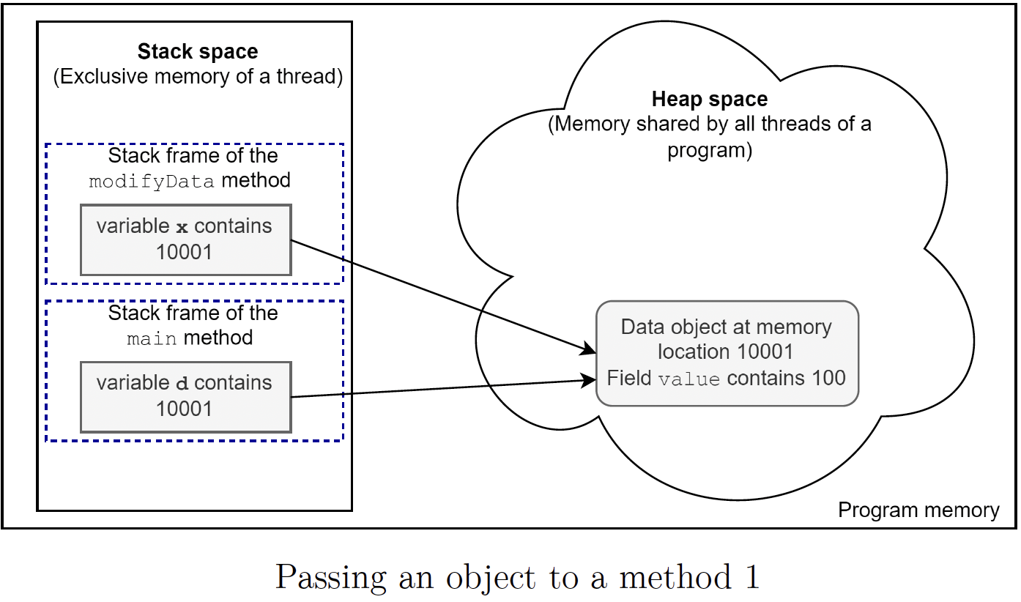
11.3 Passing object references and primitive values into methods 11.3.2 Passing objects to methods
(code illustration snippet 26) - pass by reference

Slide 12
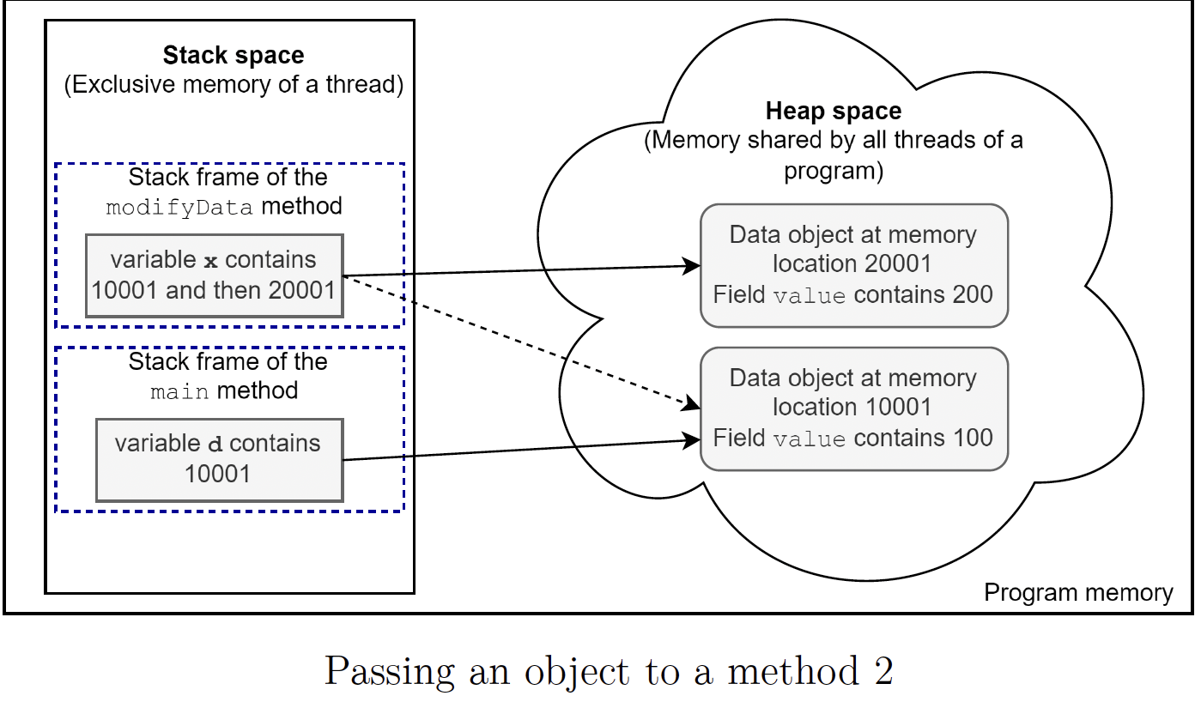
11.3 Passing object references and primitive values into methods 11.3.2 Passing objects to methods
(code illustration snippet 27) - pass by reference

Slide 13
11.3 Passing object references and primitive values into methods 11.3.2 Passing objects to methods
(code illustration snippet 28) - pass by reference

Slide 14
11.3 Passing object references and primitive values into methods 11.3.3 Returning a value from a method
- Returning ... value: Might be able to return the value directly or through ...
- Returning ... value: Might be able to return the ... directly or through ... variable, both ways are the same because the all return the ... address

Slide 15
11.4 Apply the static keyword to methods and fields – 11.4.1 Apply the static keyword to methods and fields
- We can declare a class member as .... In this case, the ... keyword must stand before the ... of the field or the ... of the method
(code illustration snippet 29)

Slide 16
11.4 Apply the static keyword to methods and fields – 11.4.2 Accessing static field
- ... member existed as a member of the ... itself, not ... itself => to access ... field, can use the ... name
(code illustration snippet 30)
- accessing ... field using ... name is recommended but we can also call it using ... name
(code illustration snippet 31)
- The example that we just gone through highlight an important aspect of static field, accessing ... field is determined by ... not by ... at .... The ... will check .... type of the variable and if they are static, it will ... the command from accessing ... field using ... name to accessing ... field using ... name
(code illustration snippet 32)

Slide 17
11.4 Apply the static keyword to methods and fields – 11.4.3 Accessing static members from the same class
- ... memeber is accessible from ... and .... method in the same ... (here using its own name)
(code illustration snippet 33 – 34)

Slide 18
11.4 Apply the static keyword to methods and fields – 11.4.4 Accessing instance members from a static method
- Static method belongs to the ... context not ... context => static method will only executed with the ... not with ... since static method doesn't related with ... Meanwhile, instance method can access to the ... which call the method by using "this" => static member can't use this since it doesn't related to ...
- In this case, "this" is not ... declared, but the compiler will ... its existance inside ... When compiler see ... field is accessed inside ..., it will use "this" (if we don't do that). But static method can't do that since no ... are related to static method
(code illustration snippet 35)
- We don't have to write "this", since "this" is needed when ...
- A misunderstood statement is that "static method cant access ...", this is incomplete because static field can access ... if they ...
(code illustration snippet 36)

